Slide 1
Goals (at least my goals)
Assemble genome
Find sex marker
Estimate effective population size
Notes:
HI everyone, my name is Shannon Joslin. I’ll be talking to you about the tasks that I am working on for this project.
The first, is to assemble a high-quality reference genome. This reference genome will not only be useful to this project but is a valuable asset to all future Delta Smelt genomic studies
My second goal is to use the genome to identify a sex marker to non-invasively distinguish between male and female delta smelt in the wild and in captivity. Currently delta smelt can only be sexed through fish that are expressing eggs or sperm, or by culling the fish and identifying sex organs.
Lastly, I am working on developing a pipeline to reliably estimate the effective population size of wild delta smelt recently captured and going back in time.

Slide 2
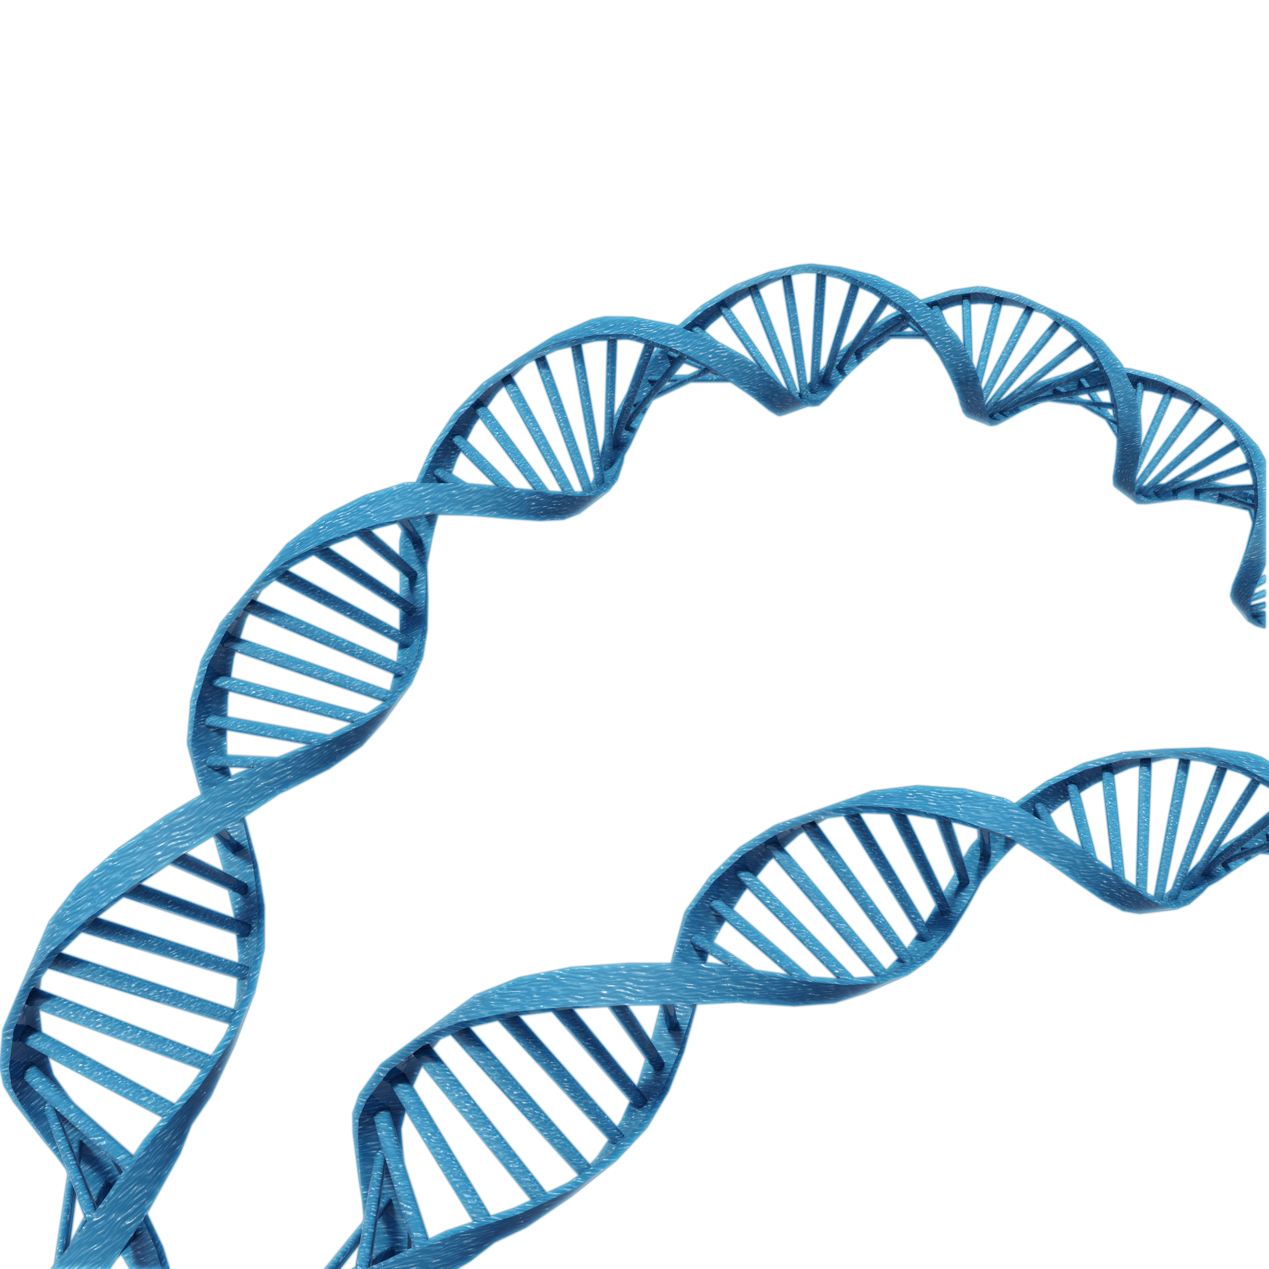
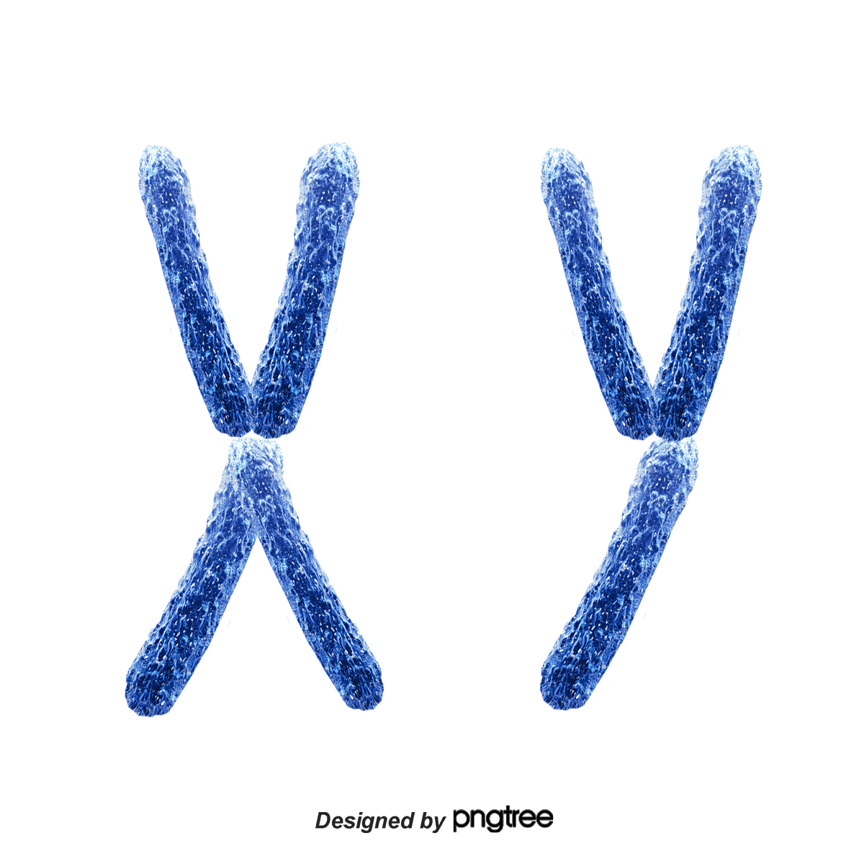
Genomes are very large
cell
nucleus
genome
chromosome
A
T
T
C
G
T
C
G
A
C
C
G
G
T
A
A
C
G
A
A
Notes:
The first thing I’d like to point out is that genomes are very big. The human genome over 3 billion base pairs long. Every cell in our body contains a copy of our genome in an organelle called the nucleus. Within each nucleus the manual of an organism’s genome is divide into parts called chromosomes––so to go back to Mandi’s analogy this is like a user manual that has many volumes in it. Think of something like those encyclopedia volumes that you saw at the library growing up. Within each one of those volumes there are millions of base pairs.

Slide 3
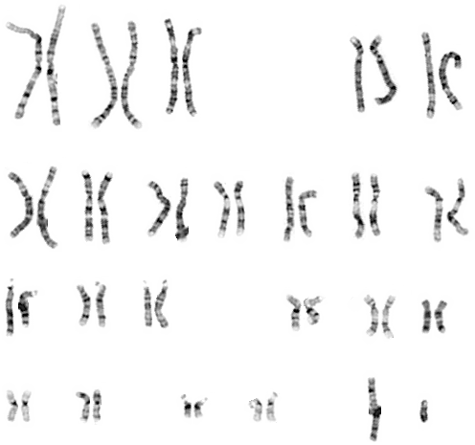
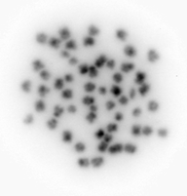
Our first step was to determine how many chromosomes to expect when assembling the delta smelt genome
Performed a karyotyping study in collaboration with Dr. Mary Delaney
Delta Smelt have 28 pairs chromosomes
high resolution human karyotype
Notes:
Our first step was to determine how many chromosomes to expect when assembling the Delta Smelt genome. We need to know how many volumes to expect in order to determine how good our final assembly is. You could imagine a really large volume being split in half and not knowing it because you’d still have two hefty sized volumes. In order to determine how many chromosomes to expect we collaborated with Dr Mary Delaney’s lab to carry out a karyotyping experiment. A karyotype gives you an image of the tightly packed chromosome. You can see a high resolution image of a human karyotype on the left. Humans have 23 pairs of chromosomes. On the right we have a lower resolution image of the delta smelt karyotype. We found that delta smelt have 28 pairs of chromosomes.

Slide 4
Next: capture all of the genome by using multiple types of sequencing technologies
Use more current sequencing technology to create a high-quality genome assembly
long reads
hi-c
A
T
T
C
G
T
C
G
A
C
C
G
G
T
A
A
C
G
A
A
linked reads
Notes:
Now that we know the number of chromosomes we need to assemble let talk about how to do that. The best way to obtain a high quality assembly is by using multiple types of sequencing technologies. These technologies diversify how and what sequences you can capture and assemble. Long reads will span a relatively long distance, so they may capture entire chapters in a volume. However, they are quite error prone so one in every twenty words may be wrong. Linked reads are shorter and more accurate, so they will give you a series of sentences and say the sentences all come from a particular chapter. We can use these reads to correct the errors in the long reads. Hi-c will tell you where the chapter lie in relation to one another. For example, if you think about the example of an encyclopedia hi-c would tell you that the B section is always surrounded by the A section and the C section.

Slide 5
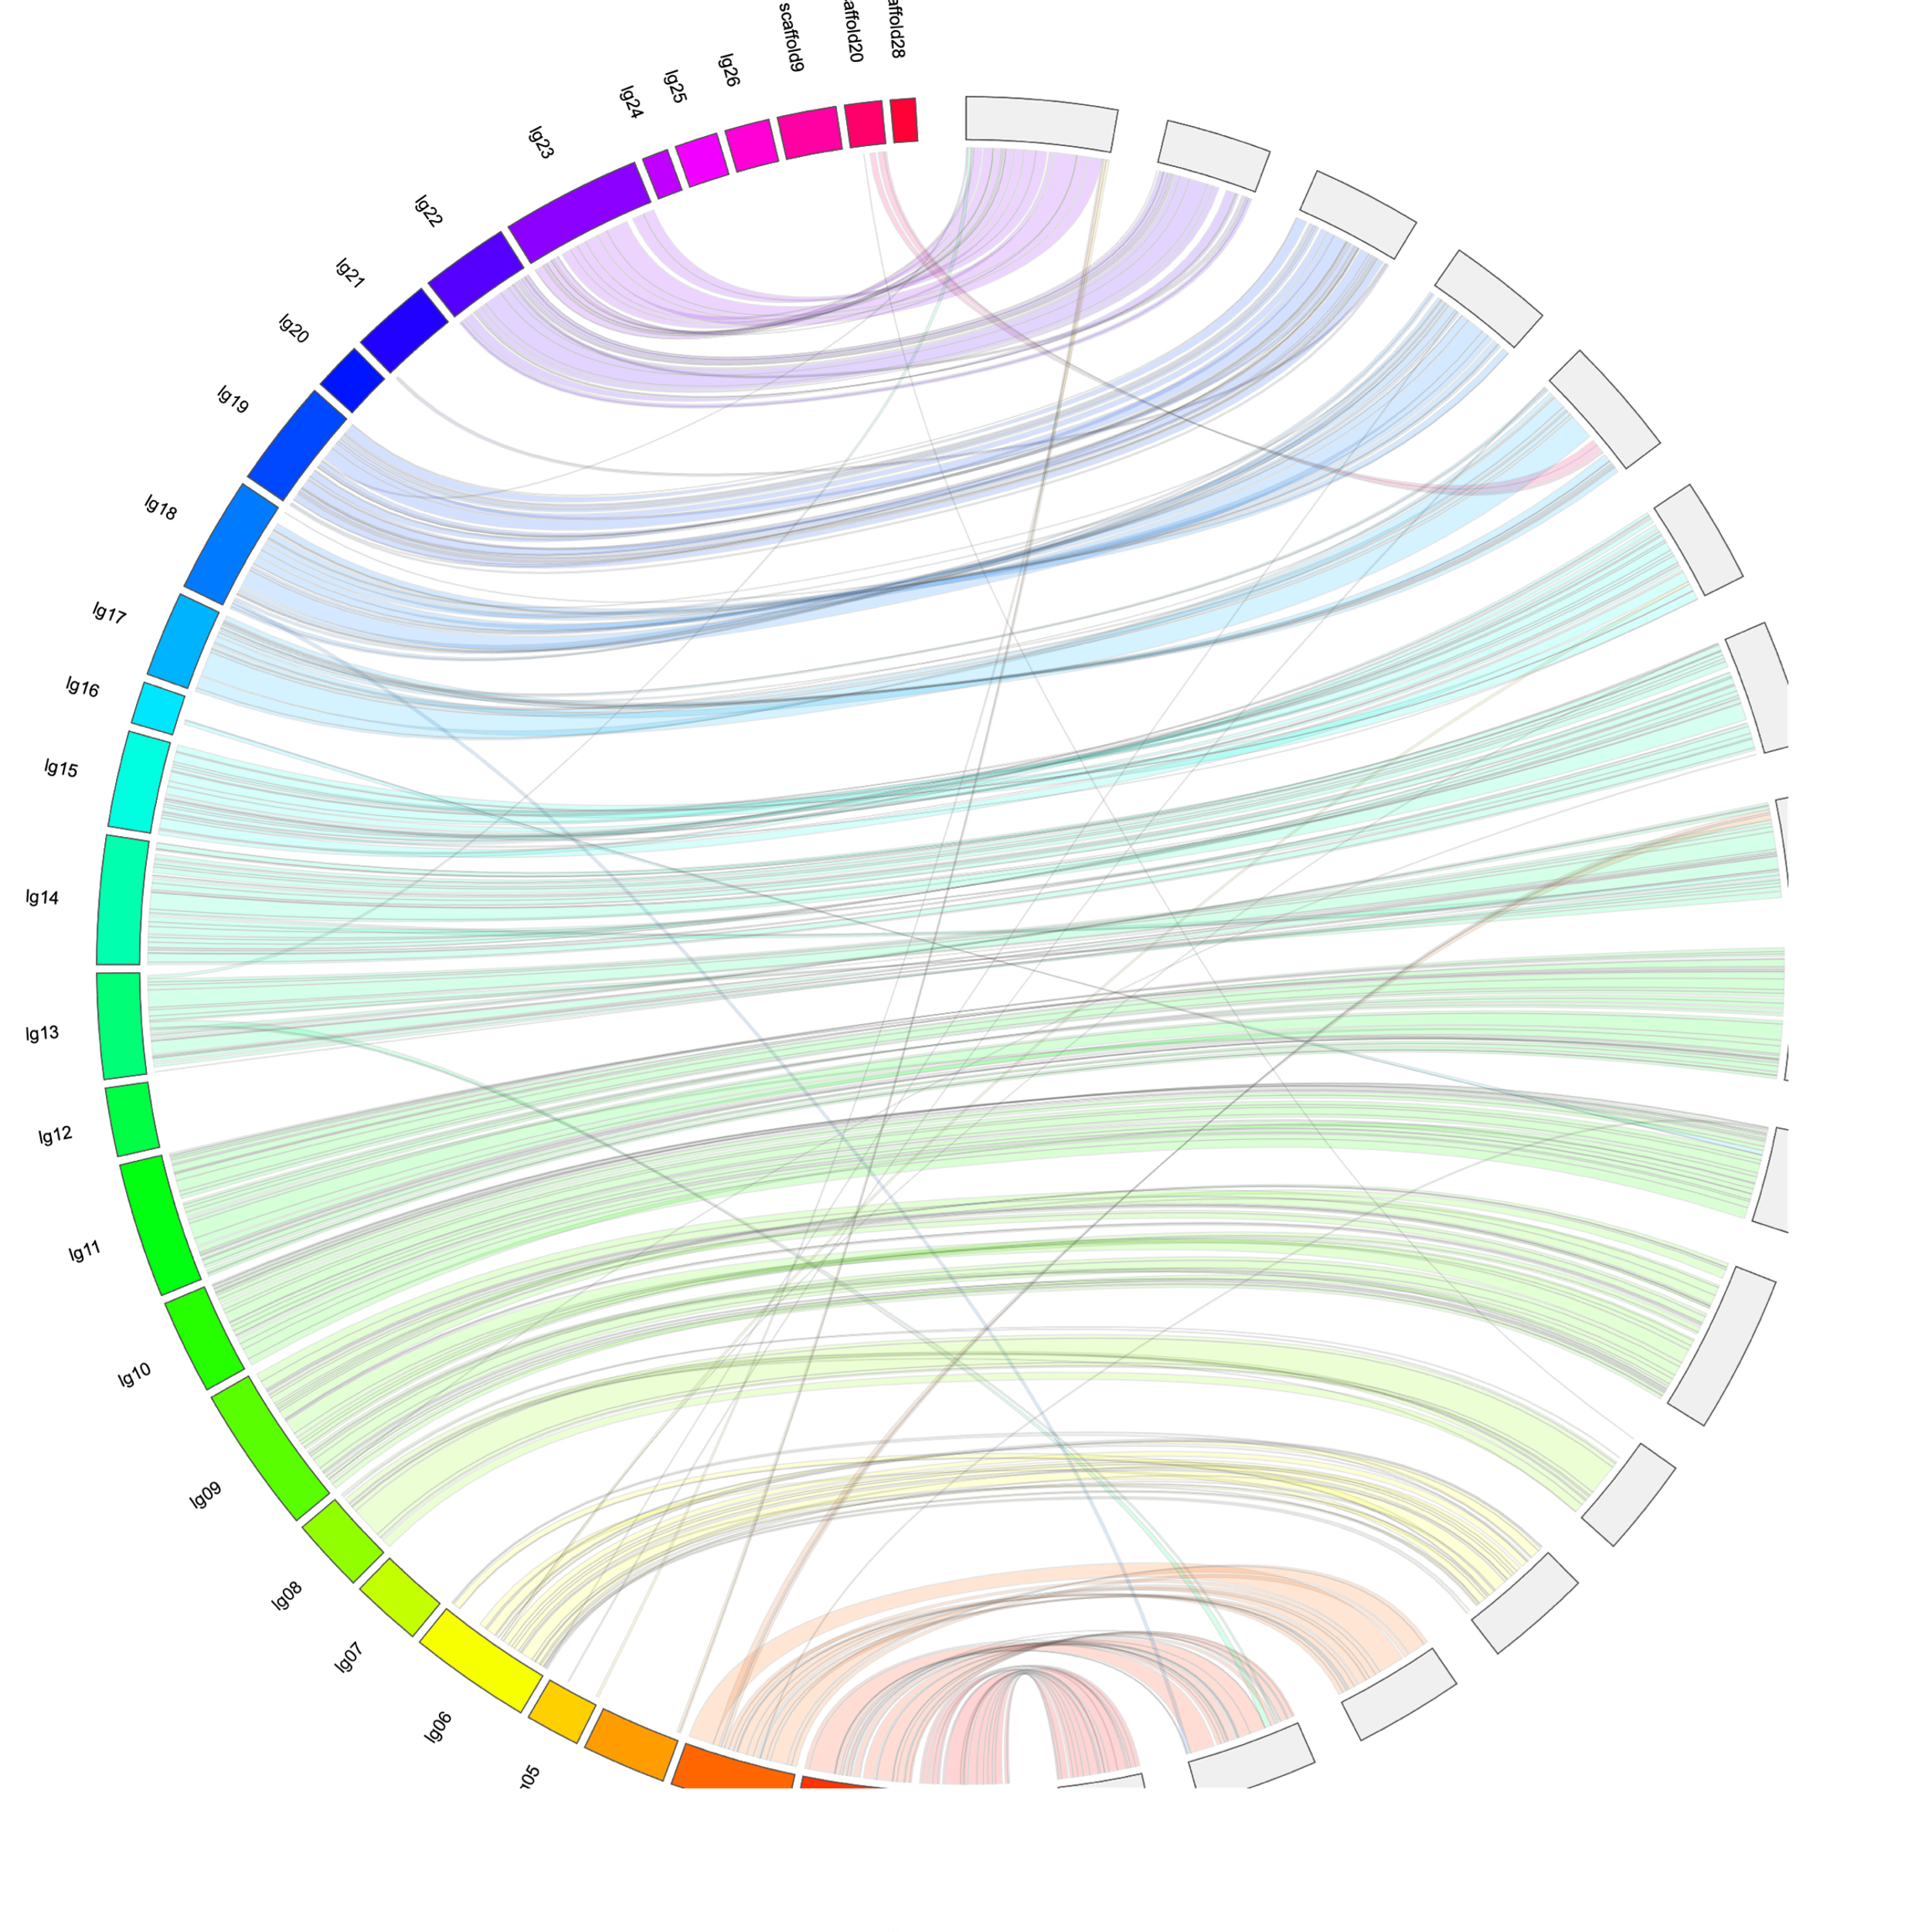
We achieved two high quality assemblies
MALE
FEMALE
One Male
One Female
Each sex assists in validating the other assembly
Notes:
We sequenced one male and one female fish with each of these technologies and got two high-quality assemblies. When I say high quality I mean contiguous which is that we’ve place most of the text of the manual into corresponding volumes. We can use both of the assemblies to validate and correct the other assembly. If you look at the figure on the right you’ll see a circular plot the the male assembly on the left and the female on the right. Each block corresponds to a chunk of sequence that was assembled into a chromosome (or a volume of the manual). The strings spanning from the male to female assemblies, that is from the left side to the right side, identify areas that are the same between the two assemblies. So we can see regions that appear to be assembled the same in each the two sexes and you can see regions that we need to manually look into to resolve if they are correct in either the male or female assembly. There are two main things to look at:

Slide 6
We achieved two high quality assemblies
MALE
FEMALE
One Male
One Female
Each sex assists in validating the other assembly
Misassemblies
Notes:
The first is looking for misassemblies––when the assembly is correct in one sex and not in the other. Here we can see there is a potential misassemblie in the 13th male chromosome. This chromosome has a chunk of sequence that goes to the 2nd female chromosome. However, most of that 2nd female chromosome corresponds to the 2nd male chromosome. So we’ll need to look into see which is correct!

Slide 7
We achieved two high quality assemblies
MALE
FEMALE
One Male
One Female
Each sex assists in validating the other assembly
Misassemblies
Placing sequences
Notes:
Additionally, we can also identify unassembled sequences to incorporate into the chromosomes. Here you can see that there is this chunk of sequence at the top of the male assembly that look like it should be placed into chromosome 17 based on it having matching sequence to female chromosome 17

Slide 8
How does this genome help?
Reference genomes are necessary to compare individuals’ DNA
Must know that we are comparing apples to apples
Before we used a RAD-sequencing based reference genome
RAD sequencing
Notes:
So a high quality genome is all good and well but how does it help genomic studies? All genomic studies need reference genomes to compare sequences across individuals. That is we have to make sure that a sequence from individual A comes from the same region in individual B and we do this by lining them up next to the reference. Previously all of our genetic analyses used a RAD-sequencing based reference genome. This RAD assembly is created from a few random individuals’ very short DNA sequences located throughout the genome. If the blue line is a segment of the true genome of Delta Smelt RAD gives us data at these red points. RAD give us about 3-600 base pairs chunks of DNA scattered throughout the genome. You can imagine that with a genome length of roughly 500 million we would get a lot of those little chunks back. Unfortunately, we cannot connect these sequences to one another, so what we end up getting looks is something more like this:

Slide 9
How does this genome help?
Reference genomes are necessary to compare individuals’ DNA
Must know that we are comparing apples to apples
Before we used a RAD-sequencing based reference genome
RAD sequencing
Notes:
So not only do we not know where these segments lie in relation to one another, we have captured relatively little of the genome

Slide 10
Our new assembly is much more contiguous.
Estimated genome size = 465 Mbp
 | RAD Assembly | New Assembly
Assembly Length | 12,905,745 bp | 437,273,953 bp
% of Estimated Genome | 2.58% | 94.4%
Average Length | 472 bp | 1,162,963 bp
Number | 27,297 | 376
New Assembly
DNA segment
Notes:
Here we can see that the RAD assembly has about 27 thousand of these little bits of DNA spread across the genome. The assembly captures about 2.6% of the estimated 465 million base pair genome. If we compare that to our new assembly you can see that we have an average string of characters that is over 1 million base pairs in length and there are only 376 chunks of DNA which capture about 95% of the expected genome size. You may be thinking “376 is way more than the 28” that I promised and you’re right. However, this is the average length of the total number of sequences that were assembled. If you look at the plot below you will see the length of each assembled DNA chunk on the y axis and each sequence on the x-axis. You may note that most of the assembly is captured in the first 30 chunks of DNA that we assembled. The rest of the remaining assembled chunks are quite small and are likely repetitive sequences that cannot be accurately placed within the genome.

Slide 11
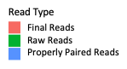
RAD assembly metrics
Birth Year | Average Alignment | Birth Year | Average Alignment
1993 | 35.3% | 2007 | 80.8%
1995 | 74.5% | 2008 | 80.8%
1996 | 69.6% | 2009 | 79.7%
1997 | 65.7% | 2010 | 78.0%
1998 | 70.7% | 2011 | 77.7%
1999 | 74.0% | 2012 | 77.7%
2000 | 70.3% | 2013 | 77.0%
2002 | 81.4% | 2014 | 77.6%
2004 | 81.2% | 2015 | 78.8%
2006 | 80.9% | 2016 | 78.7%
 |  | All Years Combine | 74.5%
number of individuals
number of reads
Notes:
Previous analyses used the RAD reference genome. Here we can see the number of sequences (or reads) that aligned to the reference. Remember that we can only use sequences that align in all individuals in our analyses. We see that across all the years we see a range of alignments from 35% to 81% with an average of 74.5%. So we are missing over 25% of our data in most individuals. This shows in the plot to the left––we can see the number of individuals that have a given number of reads. The green is the raw unaligned data from the individual, while the pink is the number of useable reads after alignment. We see a sizable decrease in the number of usable reads after alignment. The lack of aligned reads is something that may lead to technical issues as we are not getting all of the information that we can from our data. Additionally, to get reliable estimates in our analyses we can only use SNPs that align from all of our individuals –– over 20% of reads didn’t align to our de novo RAD seq based assembly

Slide 12
Alignments improved with with the new assembly
 | RAD Assembly Alignments | New Assembly Alignments
All Years Combine | 74.5% | 92.6%
Notes:
As one might expect with a more contiguous genome we are seeing much better alignment statistics when we use our new reference genome.

Slide 13
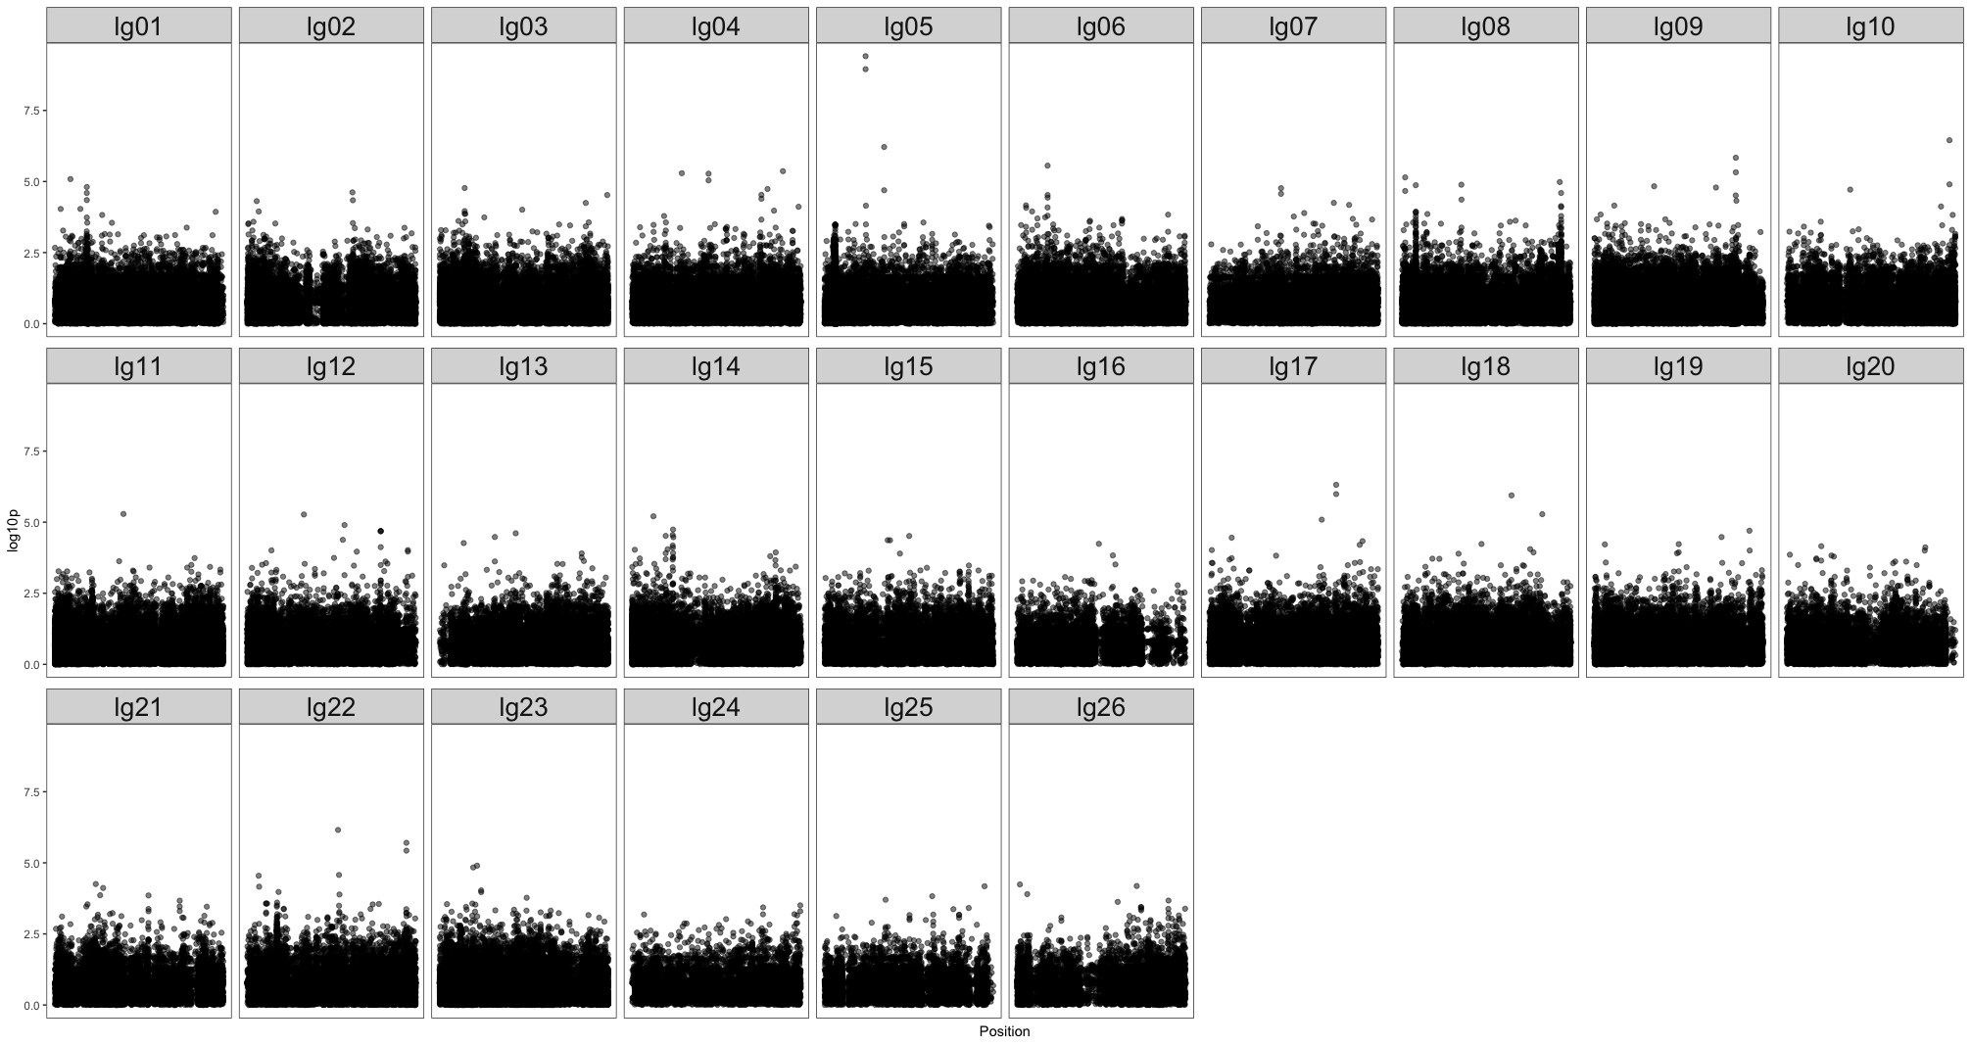
How we’ve already used our more contiguous genome
Sex Marker
Association Study

Slide 14
Estimate the effective population size of wild delta smelt
Effective population size (N_{E}) determines how quickly populations are losing genetic diversity
50:500 rule
Can look at historical or contemporary N_{E}
Historical N_{E} is usually fairly stable
Contemporary N_{E} can give the effective population size of just a few generations back
Notes:
50:500 doesn’t apply to aquatic populations at well (generally used for terrestrial mammalian populations)

Slide 15
Historical datasets
2208 wild fish from 1993 – 2016
RAD sequencing for each fish
Our initial estimates used the RAD Assembly

Slide 16
Historical N_{E} using RAD assembly

Slide 17
Contemporary N_{E} using RAD assembly

Slide 18
Next steps
Improve genome assembly
Re-estimate effective population size (1993-2016)
Analyze new data from 420 wild fish (2017 – 2018)
Validate sex marker
Finish PhD, get vaccinated and take a vacation

